Slide 1
MATLAB Programming
Lab
Instructor: 黃世強 (Sai-Keung Wong)

Slide 2
About demo video and demo programs.
A demo video or a demo program may have bugs. They show or illustrate roughly the results. These results may not be exactly the same as the requirements. They are for your own reference. You must follow the instruction to finish your programs.

Slide 3
About Program Parameters
Please try different parameters to see the outcomes.

Slide 4
File content header
At the top of the file, write down your name, ID, email address, department, and date. If you do not do so, you receive a score of zero in the corresponding problem.
%%%%%%%%%%%%%%%%%%%%%%%%%%%
% Midterm Number: …
% Problem number: …
% Student Name: …
% Student ID: …
% Email address: …
% Department:
% Date: ….
%%%%%%%%%%%%%%%%%%%%%%%%%%%%

Slide 5
File content
For each problem, display the problem number before showing the results.
close all; clear; clc; % close all windows
% clear variables, and clear screen
disp(‘Lab Problem 2.1') % show Problem 2.1

Slide 6
Problem 1.1.
There are 4 pairs of functions. The two functions of each pair are as follows:
y_{i,1}(x) = cos(2*i*x), y_{i,2}(x) = 2 x sin(i²*x)/(x²+1) – 2,
for i =1, 2, 3, and 4.
Interpolate linearly the two functions of each pair i by:
y_{i}(x) = k y_{i,1}(x) + (1-k) y_{i,2}(x).
[4%x4] Animate the interpolation process by changing k from 1 to 0, with decrement 0.01. Pause for 1/30 second per step. Show the result on the same figure. Partition the figure into a 2x2 grid. Each pair of functions is shown in a region. The original functions must also be plotted. x in [-10, 10]. The two original curves are plotted in red and blue, respectively.
[5%] Show the title of each figure. The title format must be correct. Set the font size properly
[4%] Set the linewidth of the curves properly so that similar results are obtained (see demo). The original curves are thicker than the interpolated curves.

Slide 7
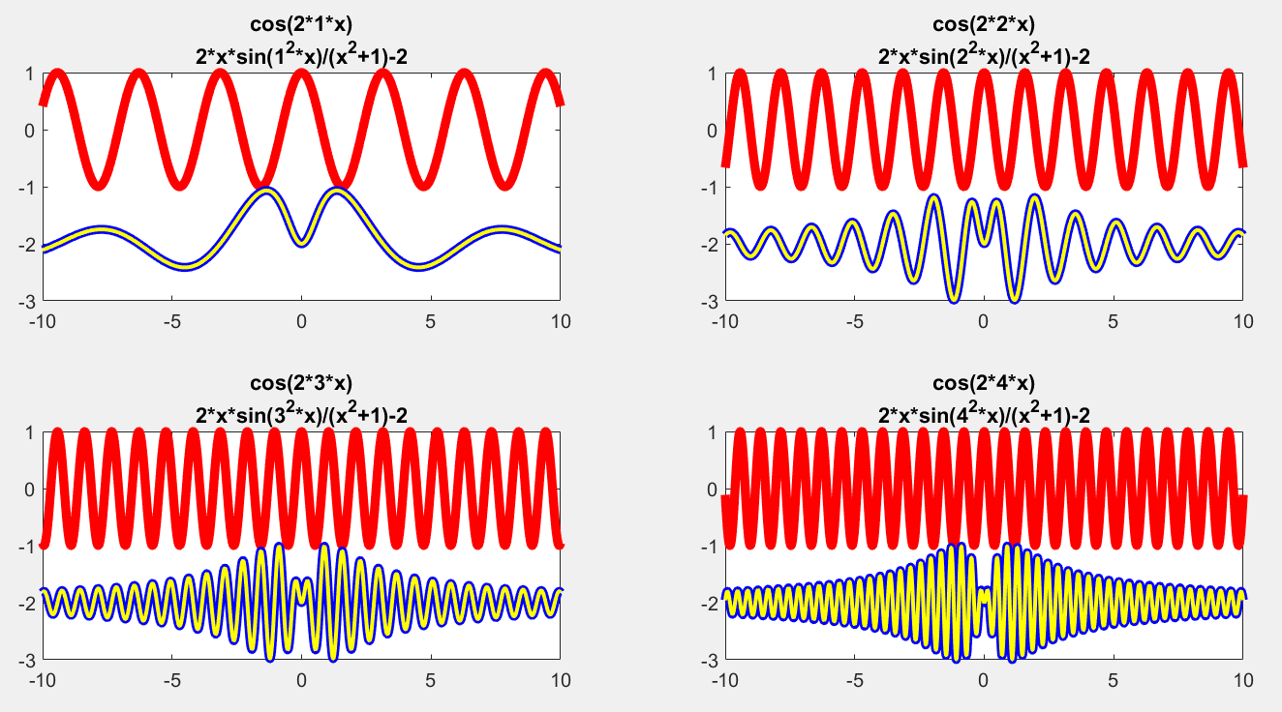
Problem 1.1
y_{i,1}(x) = cos(2*i*x), y_{i,2}(x) = 2 x sin(i²*x)/(x²+1) – 2,
for i =1, 2, 3, and 4.

Slide 8
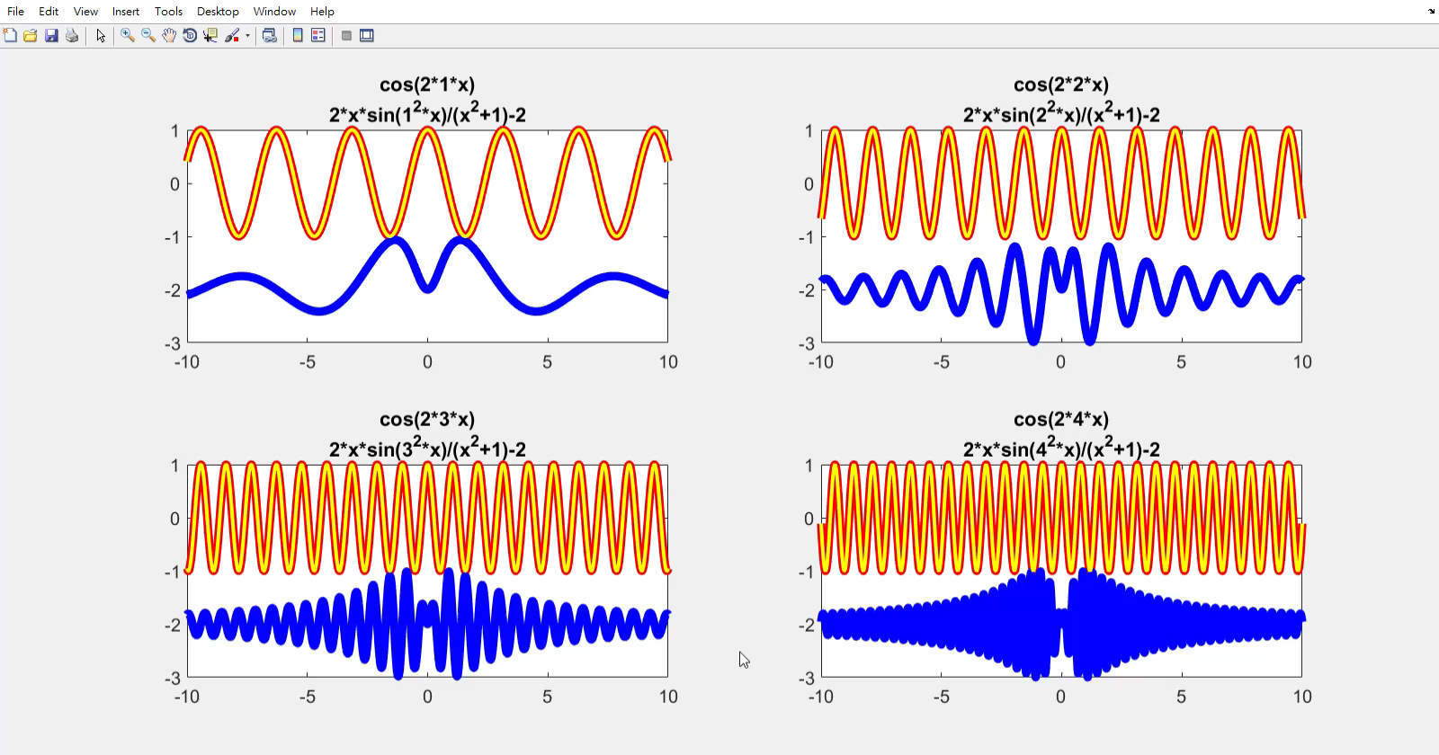
Problem 2.3. Demo video
The yellow curve is not easy to see :D
What do you think?

Slide 9
End
Enjoy MATLAB Programming.

